Slide 1
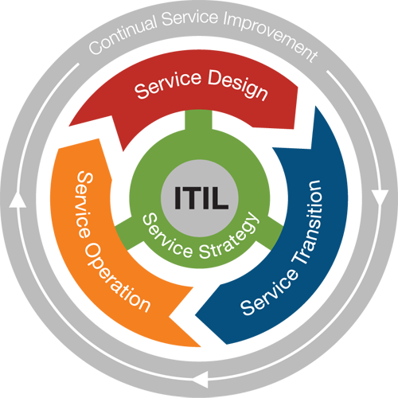
IT Service Management
ITSM – lifecycle
Faglærer: Kasim Ali

Slide 2
ITSM Processes in ITIL
ITIL is the most popular ITSM best practice framework.
ITIL is based of five Service Lifecycle modules (split across 5 core books. Each of these books relates to a different part of what ITIL calls the Service lifecycle):
Service strategy – as the name suggests, it’s the preparation and planning that the service provider must do to deliver services that meet business needs.
Service design – The objective is to design new IT services as well as changes and improvements to existing ones
Service transition – Provides the development and improvement of new and changed services before transitioning into operations
Service operation – it’s where the service desk, and its activities, sits.
Continual service improvement – which is all about improvement, whether that be keeping up with changing business needs or optimizing operational activities.
Each of them containing a number of ITIL Processes and Functions.
The key to running efficient IT Service Management is knowing who does what.
Therefore, within the ITIL framework you’ll find numerous roles involved in the processes.
Some roles span across several processes, and have different influence on the process itself.

Slide 3
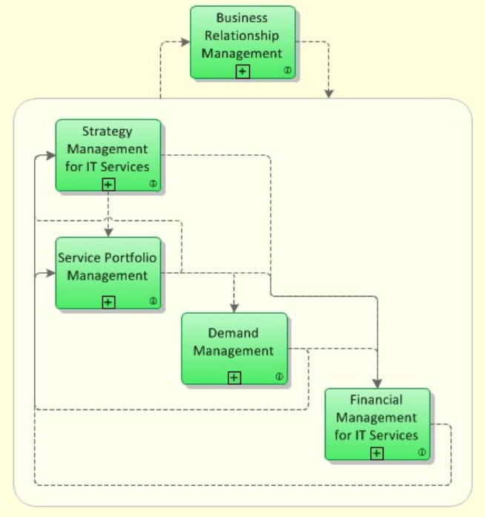
Service Strategy
Service Strategy provides a way how to design, develop and implement Service Management.
Service Strategy determines which types of services should be offered to which customers on which markets.
The following main processes are part of the ITIL Service Strategy lifecycle:
Strategy Management for IT Services
Process Objective: To assess the service provider's offerings, capabilities, competitors as well as current and potential market spaces in order to develop a strategy to serve customers. Once the strategy has been defined, Strategy Management for IT Services is also responsible for ensuring the implementation of the strategy.
Service Portfolio Management
Process Objective: Service Portfolio Management ensures that the service provider has the right mix of services to meet required business outcomes at an appropriate level of investment.
Financial Management for IT Services
Process Objective: To manage the service provider's budgeting, accounting and charging requirements.
Demand Management
Process Objective: To understand, anticipate and influence customer demand (efterspørgsel) for services.
Business Relationship Management
Process Objective: To maintain a positive relationship with customers.
To identify the needs of existing and potential customers and ensures that appropriate services are developed to meet those needs.

Slide 4
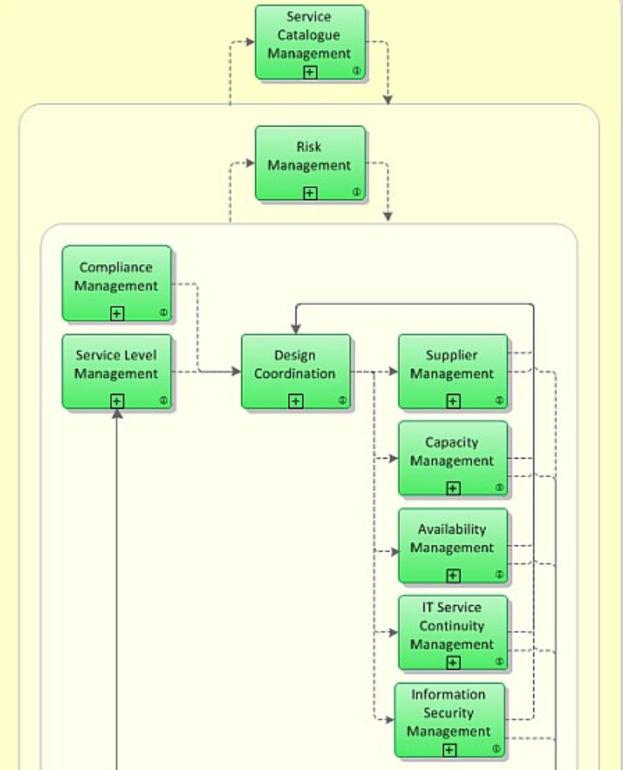

Service Design
The objective of ITIL Service Design is to design new IT services, as well as changes and improvements to existing IT-service.
Then it will be passed to Service Transition to be evaluated, built and tested, before deployed as a new or changed IT-service.
The following main processes are part of the Service Design lifecycle:
Design Coordination
Process Objective: To coordinate all service design activities, processes, tools and resources.
Ensure the effective design of new or changed IT services, architectures, technology and processes.
Service Catalogue Management
Process Objective: To ensure that a Service Catalogue is produced and maintained, containing information on all operational services
Service Level Management
Process Objective: To negotiate Service Level Agreements with the customers and to design services in accordance with the agreed service level targets.
Ensure that all suppliers meet their contractual commitments.
Ensure, the capacity of IT services and IT infrastructure is able to deliver the agreed service level targets in a cost effective and timely manner
Ensuring, all IT infrastructure, processes, tools, etc. are appropriate for the agreed availability services.
To manage risks that could seriously impact IT services
Ensure the confidentiality, integrity and availability of an organization's information, data and IT services.
Define a plan for the future development

Slide 5
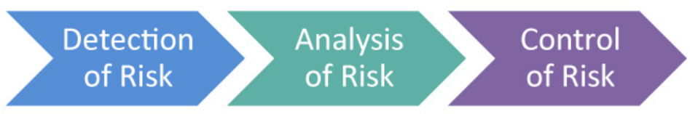
Service Design – Cont.
Risk Management
The main objective of risk management is to detect, analyze and control the risks.
identifying the threats and vulnerabilities which can affect organization’s assets.
collection and calculation of data
making decisions after monitoring the surroundings in order to ensure that the older threats and vulnerabilities are effectively countered.

Slide 6
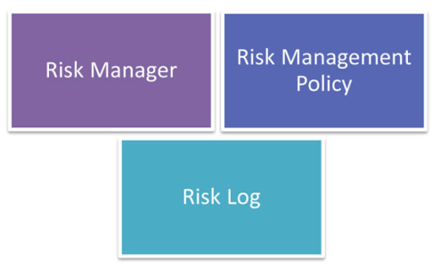
Service Design – Cont.
Components of Risk Management
Risk Manager
A risk manager is someone who is responsible for detecting, analyzing and controlling risks.
Risk management policy
Is a set of guidelines, which describe the organization’s managing of risk.
Risk Log
Is a tool used by risk managers, during the risk management process, to keep track of the detected risks and the possible solutions
Capacity Management
Process Objective: To ensure that the capacity of IT services and the IT infrastructure is able to deliver the agreed service level targets in a cost effective and timely manner.

Slide 7
Service Design – Cont.
Availability Management
Process Objective: To define, analyze, plan, measure and improve all aspects of the availability of IT services. Availability Management is responsible for ensuring that all IT infrastructure, processes, tools, etc. are appropriate for the agreed availability targets.
IT Service Continuity Management
Process Objective: To manage risks that could seriously impact IT services. ITSCM ensures that the IT service provider can always provide minimum agreed Service Levels, by reducing the risk from disaster events to an acceptable level and planning for the recovery of IT services. ITSCM should be designed to support Business Continuity Management.
Information Security Management
Process Objective: To ensure the confidentiality, integrity and availability of an organization's information, data and IT services.
Compliance Management
Process Objective: To ensure IT services, processes and systems comply with enterprise policies and legal requirements.
Architecture Management
Process Objective: To define a plan for the future development of the technological landscape, taking into account the service strategy and newly available technologies.
Supplier Management
Process Objective: To ensure that all contracts with suppliers support the needs of the business, and that all suppliers meet their contractual commitments.

Slide 8
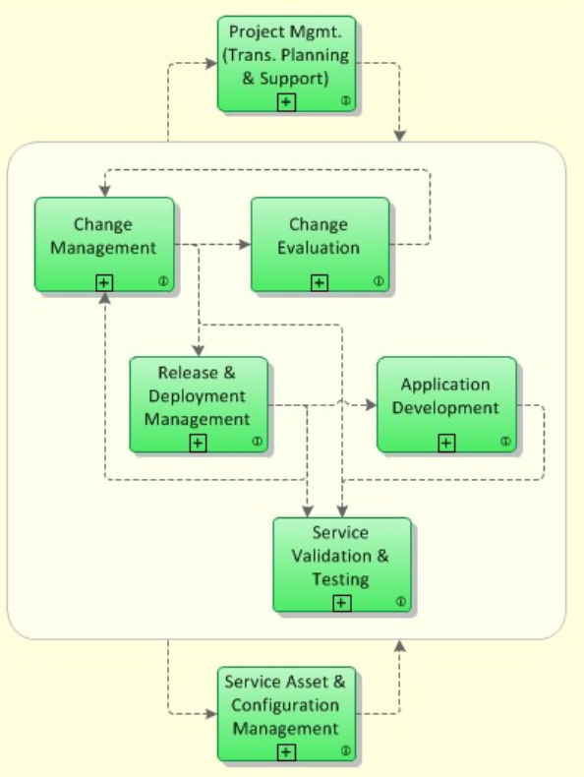
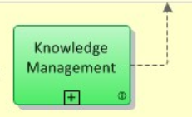
Service Transition
The Service Transition provides the development and improvement of new and changed services before transitioning into operations.
The following main processes are part of the ITIL stage Service Transition:
Change Management
Process Objective: To control the lifecycle of all Changes.
Is a process designed to minimize risks while making changes in IT infrastructure and with minimum disruption to IT services.
Change management also helps to minimize the impact of related incidents on service
Change Evaluation
Process Objective: To assess major Changes, like the introduction of a new service or a substantial change to an existing service, before those Changes are allowed to proceed to the next phase in their lifecycle.
Project Management (Transition Planning and Support)
Process Objective: To plan and coordinate the resources to deploy a major Release within the predicted cost, time and quality estimates.
Application Development
Process Objective: To make available applications and systems which provide the required functionality for IT services. This process includes the development and maintenance of custom applications as well as the customization of products from software vendors.

Slide 9
Service Transition – cont.
Release and Deployment Management
Process Objective: To plan, schedule and control the movement of releases to test and live environments. The primary goal of Release Management is to ensure that the integrity of the live environment is protected and that the correct components are released.
Service Validation and Testing
Process Objective: To ensure that deployed Releases and the resulting services meet customer expectations, and to verify that IT operations is able to support the new service.
Service Asset and Configuration Management
Process Objective: To maintain information about Configuration Items required to deliver an IT service, including their relationships.
Knowledge Management
Process Objective: To gather, analyze, store and share knowledge and information within an organization. The primary purpose of Knowledge Management is to improve efficiency by reducing the need to rediscover knowledge.

Slide 10
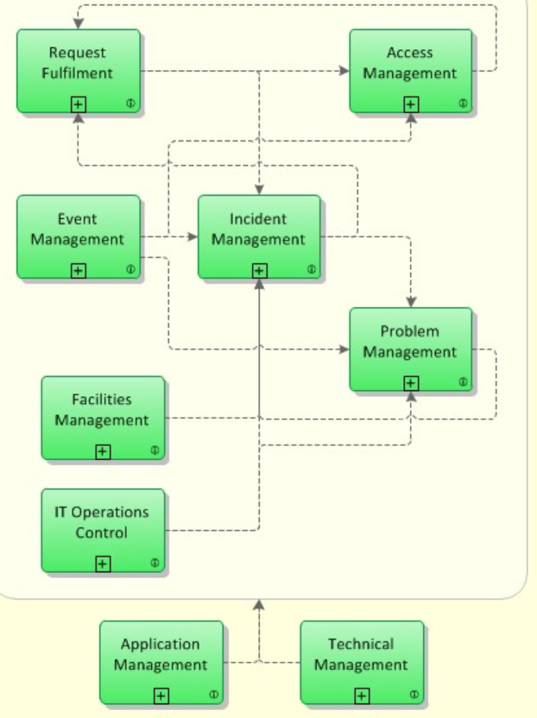
Service Operation
The objective of ITIL Service Operation is to make sure that IT services are delivered effectively and efficiently.
The Service Operation lifecycle includes fulfilling of user requests, resolving incidents, resolving service failures, fixing problems, as well as carrying out routine operational tasks.
The following main processes are part of Service Operation lifecycle module:
Event Management
Process Objective: To make sure CIs and services are constantly monitored, and to filter and categorize Events in order to decide on appropriate actions.
Incident Management
Process Objective: To manage the lifecycle of all Incidents. The primary objective of Incident Management is to return the IT service to users as quickly as possible.
Request Fulfilment
Process Objective: To fulfill Service Requests, which in most cases are minor (standard) Changes (e.g. requests to change a password) or requests for information.
Request Fulfilment is the process for dealing with Service Requests – many of them actually smaller, lower-risk, changes – initially via the Service Desk.
• Oprettelse af brugere, • Password reset

Slide 11
Service Operation –Cont.
Access Management
Process Objective: To allow authorized users the right to use a service, while preventing access to non-authorized users. The Access Management processes essentially execute policies defined in Information Security Management. Access Management is sometimes also referred to as Rights Management or Identity Management.
Problem Management
Process Objective: To manage the lifecycle of all Problems. The primary objectives of Problem Management are to prevent Incidents from happening, and to minimize the impact of incidents that cannot be prevented. Proactive Problem Management analyzes Incident Records, and uses data collected by other IT Service Management processes to identify trends or significant Problems.
Incident management
Problem management
Slukker ildebrand
Sikrer der ikke opstår ildebrand
Retter fejl så incidents ikke opstår Eller retter flere incidents
Service genoprettelse

Slide 12
Service Operation –Cont
IT Operations Control
Process Objective: To monitor and control the IT services and their underlying infrastructure. The process IT Operations Control executes day-to-day routine tasks related to the operation of infrastructure components and applications. This includes job scheduling, backup and restore activities, print and output management, and routine maintenance.
Facilities Management
Process Objective: To manage the physical environment where the IT infrastructure is located. Facilities Management includes all aspects of managing the physical environment, for example power and cooling, building access management, and environmental monitoring.
Application Management
Application Management is responsible for managing applications throughout their lifecycle.
Technical Management
Technical Management provides technical expertise and support for the management of the IT infrastructure.

Slide 13
Problem Management Incident vs. problem
Incident management
Problem management
Slukker ildebrand
Sikrer der ikke opstår ildebrand
Retter fejl så incidents ikke opstår Eller retter flere incidents
Service genoprettelse
When incidents occur, the role of incident management is to restore service as rapidly as possible, without necessarily identifying or resolving the underlying cause of the incidents.

Slide 14
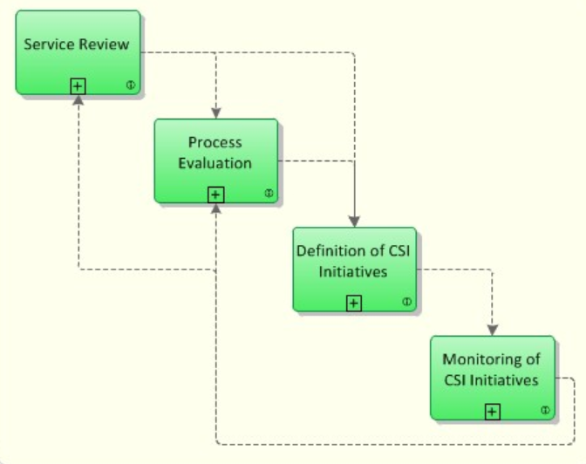
Continual Service Improvement
Er en slags ”vedligeholdelses og forbedringsfase”. Formålet her er, at man kigger på forbedringsmuligheder i samtlige faser.
Processen for Continual Service Improvement (CSI) bruger metoder fra kvalitetsstyring for at lære af tidligere succeser og fejl.
CSI forbedrer løbende effektiviteten af tjenester og processer.
Følgende hovedprocesser er en del af ITIL Continual Service Improvement (CSI):
Service Review
Procesmål: Formålet med denne proces er at forbedre servicekvaliteten, hvor det er nødvendigt, og at identificere mere økonomiske måder at yde en service på, hvor det er muligt.
Process Evaluation
Procesmål: At evaluere processer regelmæssigt. Dette omfatter identifikation af områder, hvor målretningsprocesserne ikke opnås.
Definition of CSI Initiatives
Procesmål: Definere specifikke initiativer med det formål at forbedre tjenester og processer, baseret på resultaterne af service reviews og procesevalueringer. De resulterende initiativer er enten interne initiativer, som udføres af tjenesteudbyderen på egne vegne eller initiativer, der kræver kundens samarbejde.
Monitoring of CSI Initiatives
Procesmål: For at kontrollere, om forbedringsinitiativerne foregår efter planen, og om nødvendigt indføre korrigerende foranstaltninger.

